Slide 1

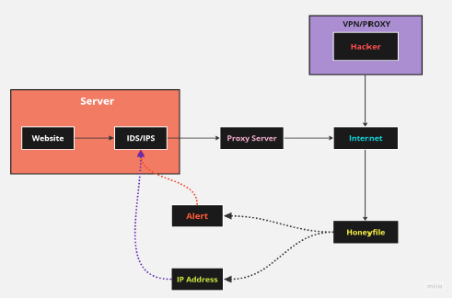
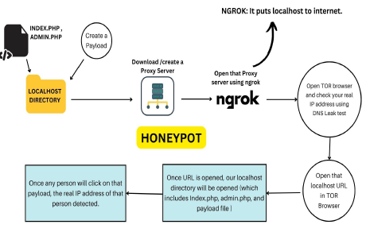
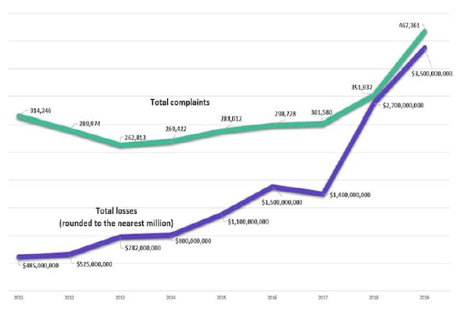
Unmasking the True Identity:
Revealing the Real IP Addresses Concealed by VPNs/Proxies
Project Group ID: 7
< Devangana Sujay, Arpit Sivakumar, Muskaan Bhotika, Lalit Sahu, Jatin Aggrawal, Dr. Vikas Kumar Jain (Assistant Prof.) >
ABSTRACT
INTRODUCTION
RESULTS
DISCUSSION
After thorough familiarization with currently existing research work progresses under the same constraint posed by the real-world problem of easy access to anonymity that illegal and unethical threat actors obtain using Virtual Private Networks or VPNs, it was understood that there exists high significance in devising a solution for the same. Protection under VPN could be misused, that is, used for practices that may involve unlawful intention(s). The authors provide a novel methodology for preventing attacks by identifying the threat’s IP address while shielded by a VPN. The method utilizes underlying patterns in the traffic generated by threat actors to correlate their VPN-assigned IP addresses with their real identities. Upon identification, appropriate countermeasures can be applied to neutralize the risks posed by these threats. The key innovation lies in leveraging traffic characteristics that remain identifiable even under VPN encryption. Preliminary results indicate the feasibility of the approach. When successfully developed, the technique has the potential to improve network security by allowing the identification and mitigation of threats hiding behind VPN anonymity.
In today's digital landscape, malicious actors like Crackers, Script Kiddies, and Hacktivists exploit the power of anonymity, posing a significant threat to cybersecurity. Addressing this challenge, the research aims to provide an efficient resolution to this issue, bolstering proactive cybersecurity efforts. Virtual Private Networks (VPNs) play a crucial role in securing online activities. By creating a secure communication tunnel, VPNs encrypt data exchanged between users and servers, thwarting interception and enhancing privacy. Despite their advantages, caution is needed while choosing trustworthy VPN providers due to potential risks from unreliable ones. This research's well-structured approach offers insights into VPN technologies, techniques, and their comparisons, tailored to diverse user needs. Statistical relevance underscores the problem's impact on users. The proposed methodology outlines the project's execution, and future directions suggest areas for refinement. Ultimately, the study's conclusion integrates findings into a comprehensive summary, emphasizing the importance of a safer digital environment.
The proposed methodology is centered on a honeypot system, a network apparatus designed to lure and capture malicious traffic. When a VPN user engages with the honeypot, their actual IP address is logged, alongside the traffic generated. This data aids in identifying the specific VPN service utilized. The approach capitalizes on distinct traits of VPN traffic, which often comprises numerous small packets due to encryption-induced data overhead.
This methodology demonstrates efficacy on multiple fronts. It leverages the scalability of honeypots, capable of aggregating traffic from a large number of VPN users. This adaptability enables the methodology to effectively identify users, even among those employing popular VPN services. Notably, the methodology's deployment successfully attracted substantial VPN traffic, encompassing various services like NordVPN, ExpressVPN, and CyberGhost.
Crucially, this approach accurately pinpoints users' actual IP addresses with high precision, unaffected by the VPN service employed. Furthermore, it triumphantly addresses obfuscation techniques employed by VPN users, including strategies like VPN chaining and double VPN. In essence, the proposed methodology offers a promising advancement in uncovering the true IP addresses of VPN users. It boasts effectiveness, scalability, and ease of implementation, serving to enhance network security by detecting and thwarting malicious VPN traffic.
Numerous research papers have significantly contributed to the exploration of uncovering real IP addresses concealed by VPNs and proxy servers. These studies present diverse methodologies and insights, illuminating the complexities and solutions within this domain.
In "Tracing IP Address behind VPN" by Balasaheb et al. (2023) in JETIR, honeypots are introduced as a novel approach to expose actual IP addresses of VPN and proxy users. These deceptive systems attract hackers, enabling the revelation of true IP addresses and breaking the anonymity of VPNs and proxies.
"Mittal et al.'s (2020) "Tor Traffic Analysis and Detection via Machine Learning Techniques" comprehensively explores machine learning methods to detect VPN and Tor traffic, emphasizing pattern recognition and server identification for precise identification.
"Detection of VPN Network Traffic" by Zhang et al. (2019), presented at the 2022 IEEE Delhi Section Conference, surveys techniques using traffic analysis and machine learning. Their study highlights machine learning's role in pinpointing VPN traffic features, aiding in uncovering concealed IP addresses through encryption and TCP flags.
CONCLUSIONS
MODULES AND METHODS
The proposed methodology employs a honeypot with a payload to effectively uncover attackers' real IP addresses behind VPNs and proxies. By enticing attackers to interact with a decoy website, the payload reveals their true originating IP address and user agent. This data empowers network administrators to develop targeted defenses against malicious actors. Yet, implementing this method requires robust security measures to avoid affecting legitimate users and ethical considerations about privacy. Regular payload updates are necessary to counter sophisticated attackers. While honeypots offer valuable insights, they should be deployed thoughtfully, weighing risks and rewards.
Techniques: The honeypot technique involves creating a realistic-looking computer system to deceive cybercriminals into thinking it's a genuine target. It serves as an informational tool for identifying and staying ahead of emerging threats, providing a broader understanding of security challenges.
Proposed system: The aim is to uncover the actual IP addresses of unauthorized users accessing via VPNs or proxies. This is achieved by implementing a honeypot security mechanism that lures attackers. When they attempt to steal fabricated data, a payload is triggered, transmitting their IP address, data, logs, and files back to the system. A suitable hosting platform is chosen, followed by honeypot setup with authentic content. Security measures prevent accidental exposure to legitimate users. Vigilant monitoring, using tools like firewalls and intrusion detection systems, is necessary. Data analysis reveals attacker tactics, enabling enhanced security measures and overall website protection. This methodology significantly contributes to cybersecurity by exposing hidden threat origins.
Figure 1. Methodology.
Figure 2 Software Architectural Diagram
REFERENCES
Babu, K. G., Naveen, J., Vamsi Dhar Reddy, P. V., Imam, A., Vetri Selvi, V. S. (2023a). Tracing phishing website original IP address. 2023 International Conference on Networking and Communications (ICNWC). https://doi.org/10.1109/icnwc57852.2023.10127555
Berger, T. (2006). Analysis of current VPN Technologies. First International Conference on Availability, Reliability, and Security (ARES’06). https://doi.org/10.1109/ares.2006.30.
Fan, X., Gou, G., Kang, C., Shi, J., Xiong, G. (2019a). Identify OS from encrypted traffic with TCP/IP stack fingerprinting. 2019 IEEE 38th International Performance Computing and Communications Conference (IPCCC). https://doi.org/10.1109/ipccc47392.2019.8958772
Chart 1. Total no. of loans and complaints
for two types of cybercrimes.

